Slide 1
Outline
Statistical Model
Terms
Probability of Pause Event:
Capacity Bounded Pause
Head-Of-Line (HOL) Blocking Pause (Modified)
Deadlock Case Analysis (Modified)

Slide 2
Outline
Statistical Model
Terms
Probability of Pause Event:
Capacity Bounded Pause
Head-Of-Line (HOL) Blocking Pause (Modified)
Deadlock Case Analysis (Modified)

Slide 3
Statistical Model - Terms
r₁ (> r^{c})
i
j
B
r^{c}
flow 1
rx
tx
rx
tx
pause
Time unit ∆t: the time for a device to send one packet to next-hop device.
Assumption: We assume a PAUSE frame can take effect immediately and lasts for ∆t.
Pause event pause(j, i, ∆t_{k}): pause(j, i, ∆t_{k}) =1 means switch j will pause switch i at time unit ∆t_{k}.
Pause probability P(pause(j, i, ∆t_{k})): the probability for event pause(j, i, ∆t_{k}) to occur.

Slide 4
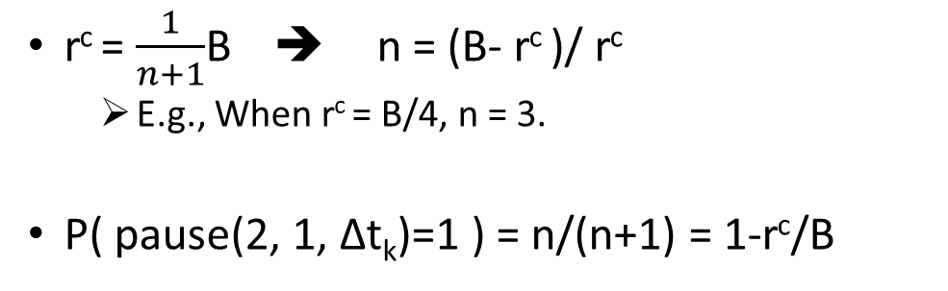
Statistical Model – Computation of P(pause(j, i, ∆t_{k}))
Case 1: Capacity Bounded Pause
r₁ (> r^{c})
1
2
B
r^{c}
flow 1
rx
tx
rx
tx
pause
P
Pause Event
P
…
P
T
P
…
P
T
……
P
…
P
T
Non-Pause Event
T
n
r^{c} = $\frac{1}{n+1}$B ➔ n = (B- r^{c} )/ r^{c}
E.g., When r^{c} = B/4, n = 3.
P( pause(2, 1, ∆t_{k})=1 ) = n/(n+1) = 1-r^{c}/B

Slide 5
Statistical Model – Computation of P(pause(j, i, ∆t_{k}))
Case 2: Head-of-Line Blocking Pause
r₁ (> r^{c})
1
2
B
r^{c}
flow 1
rx
tx
rx
tx
rx-2
pause
r₂’
?
pause
flow 2
P( pause(2, 1, ∆t_{k})=1 ) = 1-(r₂’+r^{c})/B
3
tx
4
r₂
tx
rx
Question: P( pause(1, 4, ∆t_{k})=1 ) = ? when r₂ is set to different values.

Slide 6
Statistical Model – Computation of P(pause(j, i, ∆t_{k}))
Case 2: Head-of-Line Blocking Pause
r₁ (> r^{c})
1
2
B
r^{c}
flow 1
rx
tx
rx
tx
rx-2
pause
r₂
?
pause
flow 2
P( pause(2, 1, ∆t_{k})=1 ) = 1-(r₂+r^{c})/B >0
3
tx
4
r₂
tx
rx
Condition 1: r₂ < r^{c} → P( pause(1, 4, ∆t_{k})=1 ) = 0

Slide 7
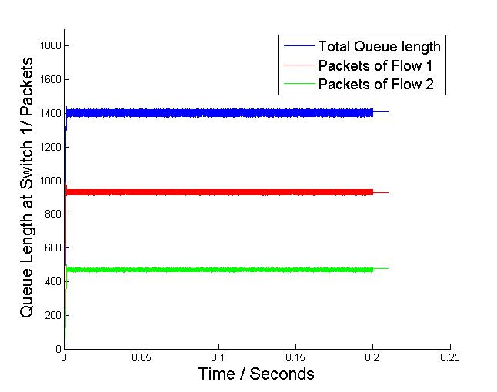
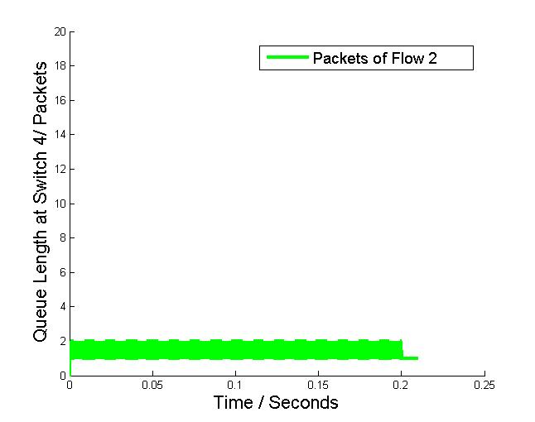
Statistical Model – Computation of P(pause(j, i, ∆t_{k}))
Simulation Results when setting r^{c} = B/2=20Gbps, r₂ =B/4=10Gbps:
1
1/2
Instant queue length of tx queue of switch 1
Instant queue length of tx queue of switch 4
At switch 1, queue length of flow 2 is half of flow 1’s, which complies with their drain rates at switch 1.
Almost no packets are queued at switch 4.

Slide 8
Statistical Model – Computation of P(pause(j, i, ∆t_{k}))
Case 2: Head-of-Line Blocking Pause
r₁ (> r^{c})
1
2
B
r^{c}
flow 1
rx
tx
rx
tx
rx-2
pause
r^{c}
?
pause
flow 2
P( pause(2, 1, ∆t_{k})=1 ) = 1-2r^{c}/B >= 0
When r^{c}=B/2, P( pause(2, 1, ∆t_{k})=1 ) =0
3
tx
4
r₂
tx
rx
Condition 2: r₂ = r^{c} → P( pause(1, 4, ∆t_{k})=1 ) = 1-r^{c}/B

Slide 9
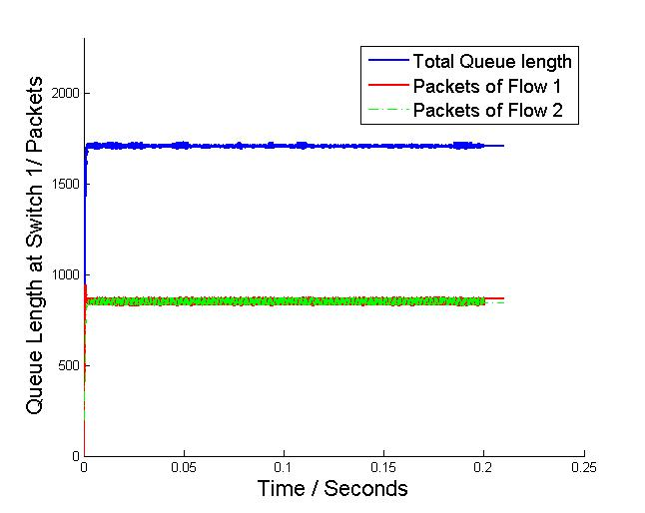
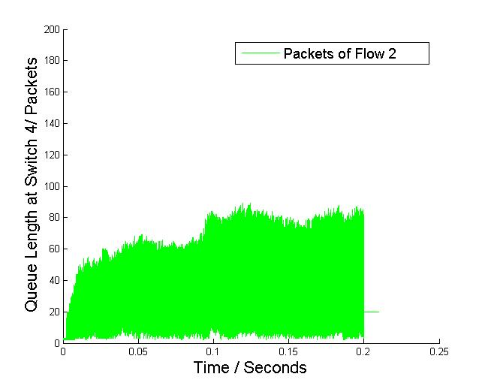
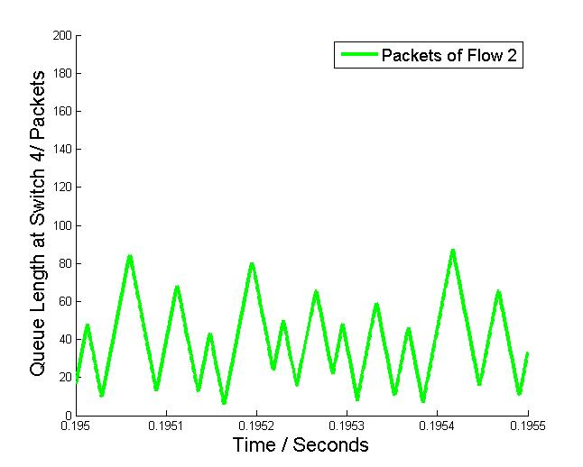
Statistical Model – Computation of P(pause(j, i, ∆t_{k}))
Simulation Results when setting r^{c} = B/2=20Gbps, r₂ =B/2=20Gbps:
Instant queue length of tx queue of switch 1
Instant queue length of tx queue of switch 4
At switch 1, queue length of flow 2 is the same as flow 1’s, which complies with their drain rates at switch 1.
Some packets are queued at switch 4. Switch 4 is paused by switch 1 intermittently.

Slide 10
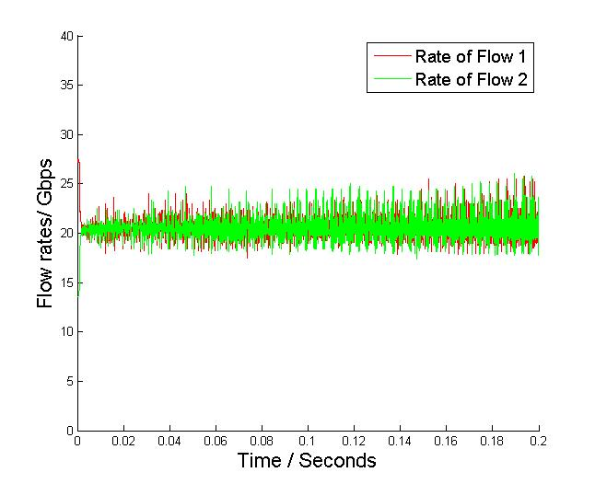
Statistical Model – Computation of P(pause(j, i, ∆t_{k}))
Simulation Results when setting r^{c} = B/2=20Gbps, r₂ =B/2=20Gbps:
At switch 1, both flows get drained at the rate of ~20Gbps which indicates that P( pause(2, 1, ∆t_{k})=1 ) =0.
Question: Why does the queue length of switch 4‘s tx queue is larger than 0? (answered in next slide)
Instant drain rate of flow 1 and flow 2 at switch 1

Slide 11
Statistical Model – Computation of P(pause(j, i, ∆t_{k}))
Case 2: Head-of-Line Blocking Pause
r₁ (> r^{c})
1
2
B
r^{c}
flow 1
rx
tx
rx
tx
rx-2
r₂=0
?
pause
flow 2
3
tx
4
r₂
tx
rx
At the very beginning, It will take some time for green packets to gradually achieve rate r^{c} at switch 1. During this period, we have r₂ < r^{c} and a small part of green packets get queued at switch 4.
This part of packets will never be drained under the condition when r₂ = r^{c} at the sender, and it will cause P( pause(1, 4, ∆t_{k})=1 ) = 1-r^{c}/B.

Slide 12
Statistical Model – Computation of P(pause(j, i, ∆t_{k}))
Case 2: Head-of-Line Blocking Pause
r₁ (> r^{c})
1
2
B
r^{c}
flow 1
rx
tx
rx
tx
rx-2
pause
r^{c}
?
pause
P( pause(2, 1, ∆t_{k})=1 )=1-r^{c}/B
flow 2
3
tx
4
r₂
tx
rx
Condition 3: r₂ > r^{c} → P( pause(1, 4, ∆t_{k})=1 ) = 1-r^{c}/B

Slide 13
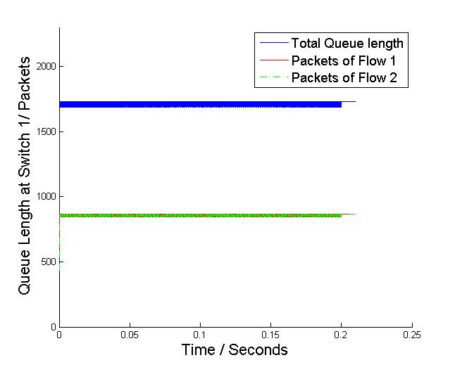
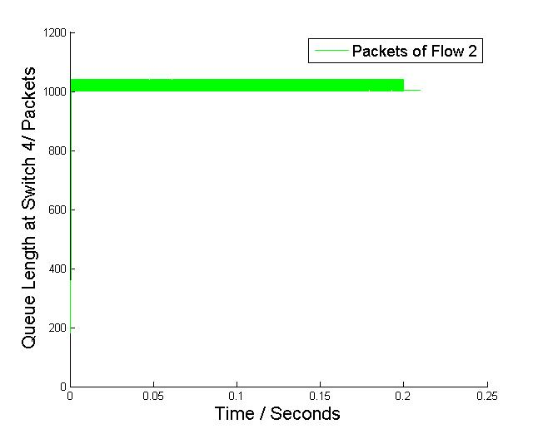
Statistical Model – Computation of P(pause(j, i, ∆t_{k}))
Simulation Results when setting r^{c} = B/2=20Gbps, r₂ =B=40Gbps:
Instant queue length of tx queue of switch 1
Instant queue length of tx queue of switch 4
At switch 1, queue length of flow 2 is the same as flow 1’s, which complies with their drain rates at switch 1.
Packets are queued at switch 4 and exceed PFC threshold. Switch 4 is paused by switch 1 intermittently.

Slide 14
Outline
Statistical Model
Terms
Probability of Pause Event:
Capacity Bounded Pause
Head-Of-Line (HOL) Blocking Pause (Modified)
Deadlock Case Analysis (Modified)

Slide 15
Analyze Deadlock Case with Statistical Model
Case 1:
flow 2
r₂ = B
1
rx
tx
r₁ = B
flow 1
3
2
tx
rx
flow 3
rx
tx
r₃ = B
Injection rates of three flows are B. For the ease of analysis, we start flow 1 and flow 2 at first, and then start flow 3.

Slide 16
Analyze Deadlock Case with Statistical Model
Case 1:
flow 2
r₂ = B
1
rx
tx
 | Queue length of switch 1 | Queue length of switch 2 | Queue length of switch 3
Flow 1 | D | 0 | D
Flow 2 | D | 0 | 0
Flow 3 | 0 | 0 | 0
r^{c} = B/2
r^{c} = B/2
r₁ = B
flow 1
3
2
tx
rx
rx
tx
Packets will build up at the tx queues of switch A and switch B.
Let D be the PFC threshold (in packets). A pause frame will be generated when the queue occupancy related to one rx queue is D+1.

Slide 17
Analyze Deadlock Case with Statistical Model
Case 1:
flow 2
r₂ = B
1
rx
tx
 | Queue length of switch 1 | Queue length of switch 2 | Queue length of switch 3
Flow 1 | D | 0 | D
Flow 2 | D | D | 0
Flow 3 | 0 | D | D
r^{c} = B/2
r^{c} = B/2
r₁ = B
r₃ >= B/2
flow 1
3
2
tx
rx
flow 3
rx
tx
r₃ = B
As queue occupancy is proportional to flow rate, the queue length of flow 3 at switch 2 and switch 3 will converge into D to achieve B/2 rate.

Slide 18
Analyze Deadlock Case with Statistical Model
Case 1:
flow 2
r₂ = B
1
Start of time 0:
rx
tx
 | Queue length of switch 1 | Queue length of switch 2 | Queue length of switch 3
Flow 1 | D | 0 | D
Flow 2 | D | D | 0
Flow 3 | 0 | D | D
r^{c} = B/2
r^{c} = B/2
r₁ = B
r₃ >= B/2
flow 1
3
2
tx
rx
flow 3
rx
tx
r₃ = B
We consider the color of first packet at three tx queues.
At time 0, it is possible that the first packet at 3-tx is red, the first packet at 1-tx is green, and the first packet at 2-tx is purple.

Slide 19
Analyze Deadlock Case with Statistical Model
Case 1:
flow 2
r₂ = B
1
End of time 0:
rx
tx
 | Queue length of switch 1 | Queue length of switch 2 | Queue length of switch 3
Flow 1 | D+1 | 0 | D-1
Flow 2 | D-1 | D+1 | 0
Flow 3 | 0 | D-1 | D+1
r^{c} = B/2
r^{c} = B/2
r₁ = B
r₃ >= B/2
flow 1
3
2
tx
rx
flow 3
rx
tx
r₃ = B
At time 0, there is a chance that the first packet at each tx queue to be injected into the tail of the next-hop switch’s tx queue.
If not, the state of the network goes back to the initial state and start a new round.

Slide 20
Analyze Deadlock Case with Statistical Model
Case 1:
flow 2
r₂ = B
1
Start of time 1:
rx
tx
 | Queue length of switch 1 | Queue length of switch 2 | Queue length of switch 3
Flow 1 | D+1 | 0 | D-1
Flow 2 | D-1 | D+1 | 0
Flow 3 | 0 | D-1 | D+1
r^{c} = B/2
r^{c} = B/2
Pause
r₁ = B
Pause
Pause
flow 1
3
2
tx
rx
flow 3
rx
tx
r₃ = B
r₃ >= B/2
A deadlock occurs due to the cyclic pause.

